Slide 1
The Late Roman Republic in 2017: Recent Developments
Tom Hillard & Lea Beness
MQ @ the Maritime Museum, April 1st, 2017

Slide 2


Slide 3


Slide 4

First Triumvirate

Slide 5


Slide 6


Slide 7


Slide 8
Trebia (218 BC)
Trasimene (217 BC)

Slide 9
Trebia (218 BC)
Trasimene (217 BC)
Cannae (216 BC)

Slide 10
Trebia (218 BC)
Trasimene (217 BC)
Cannae (216 BC)
Trebia 30,000

Slide 11
Trebia (218 BC)
Trasimene (217 BC)
Cannae (216 BC)
Trebia 30,000
Trasimene 15,000

Slide 12
Trebia (218 BC)
Trasimene (217 BC)
Cannae (216 BC)
Trebia 30,000
Trasimene 15,000
Cannae 45,500 infantry

Slide 13
Trebia (218 BC)
Trasimene (217 BC)
Cannae (216 BC)
Trebia 30,000
Trasimene 15,000
Cannae 45,500 infantry
2,700 cavalry

Slide 14
Trebia (218 BC)
Trasimene (217 BC)
Cannae (216 BC)
Trebia 30,000
Trasimene 15,000
Cannae 45,500 infantry
2,700 cavalry
48, 200

Slide 15
Cannae 45,500 infantry
2,700 cavalry
48, 200
(inc. the quaestors of both consuls, 29 military tribunes, some consular, praetorian and aedilician)

Slide 16
Cannae 45,500 infantry
2,700 cavalry
48, 200
(inc. the quaestors of both consuls, 29 military tribunes, some of consular, praetorian and aedilician rank)
“besides these, 80 senators or men who had held offices which would have given them the right to be selected to the Senate” (Livy 22. 49)

Slide 17
Cannae 45,500 infantry
2,700 cavalry
48, 200
(inc. the quaestors of both consuls, 29 military tribunes, some of consular, praetorian and aedilician rank)
“besides these, 80 senators or men who had held offices which would have given them the right to be selected to the Senate” (Livy 22. 49)
Liv. Per. 22: “There were slain 45,000 Romans, including the consul Paullus, and ninety senators, and 30 others who had been consuls, praetors or aediles.”

Slide 18
Cannae 45,500 infantry
2,700 cavalry
48, 200
Eutropius (3.10): 43,500

Slide 19
Cannae 45,500 infantry
2,700 cavalry
48, 200
Eutropius (3.10): 43,500
Appian Hannibalic War 25: 50,000

Slide 20
Cannae 45,500 infantry
2,700 cavalry
48, 200
Eutropius (3.10): 43,500
Appian Hannibalic War 25: 50,000
Plut. Fabius Maximus 16: 50,000

Slide 21
Cannae 45,500 infantry
2,700 cavalry
48, 200
Eutropius (3.10): 43,500
Appian Hannibalic War 25: 50,000
Plut. Fabius Maximus 16: 50,000
Quintilian 8.6.26: 60,000

Slide 22
Cannae 45,500 infantry
2,700 cavalry
48, 200
Eutropius (3.10): 43,500
Appian Hannibalic War 25: 50,000
Plut. Fabius Maximus 16: 50,000
Quintilian 8.6.26: 60,000
Polybius (3.117.4) 70,000

Slide 23
Cannae 45,500 infantry
2,700 cavalry
48, 200
Eutropius (3.10): 43,500
Appian Hannibalic War 25: 50,000
Plut. Fabius Maximus 16: 50,000
Quintilian 8.6.26: 60,000
Polybius (3.117.4) 70,000
Peter Brunt, Italian Manpower 225 B.C. – A.D. 14 (Oxford, 1971), Appendix 28 ‘Some Casualty Figures’, pp. 694–697.

Slide 24
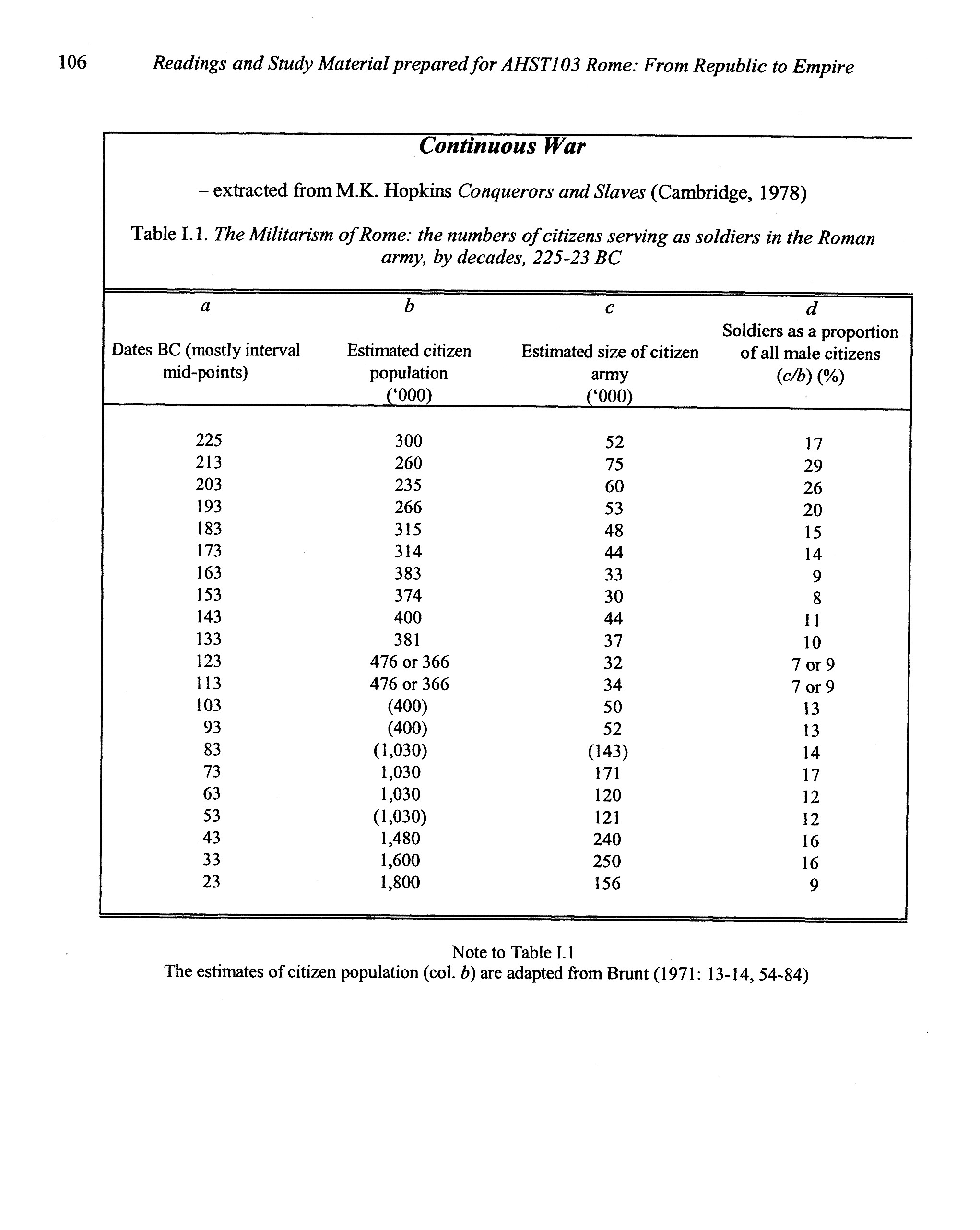

Slide 25
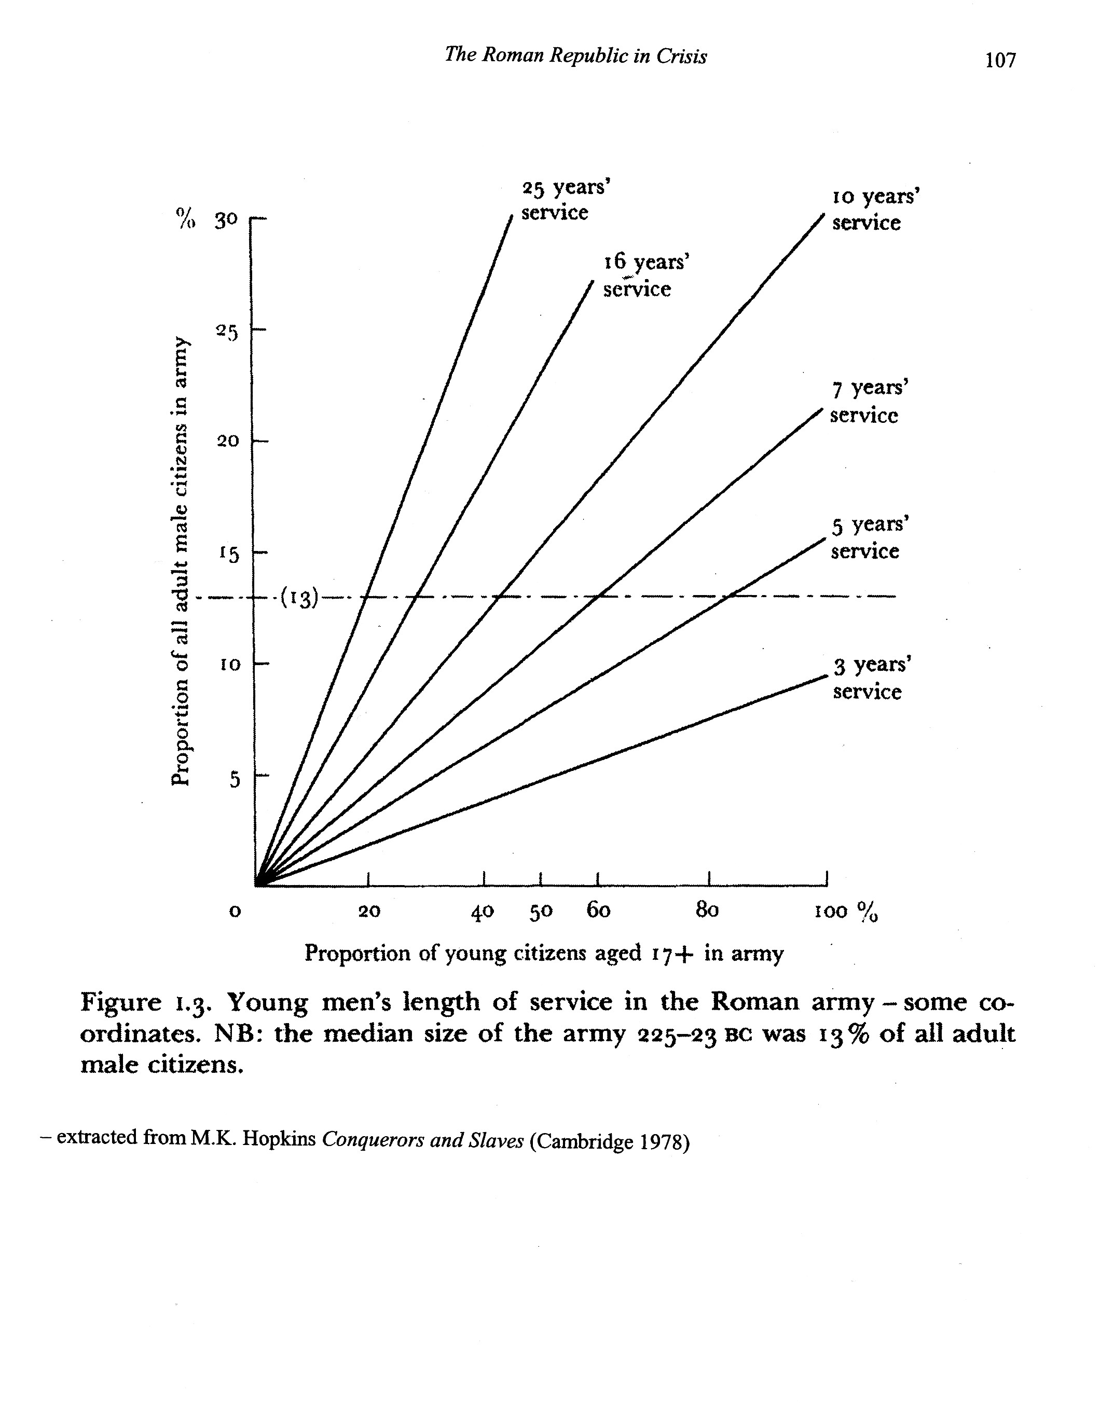

Slide 26
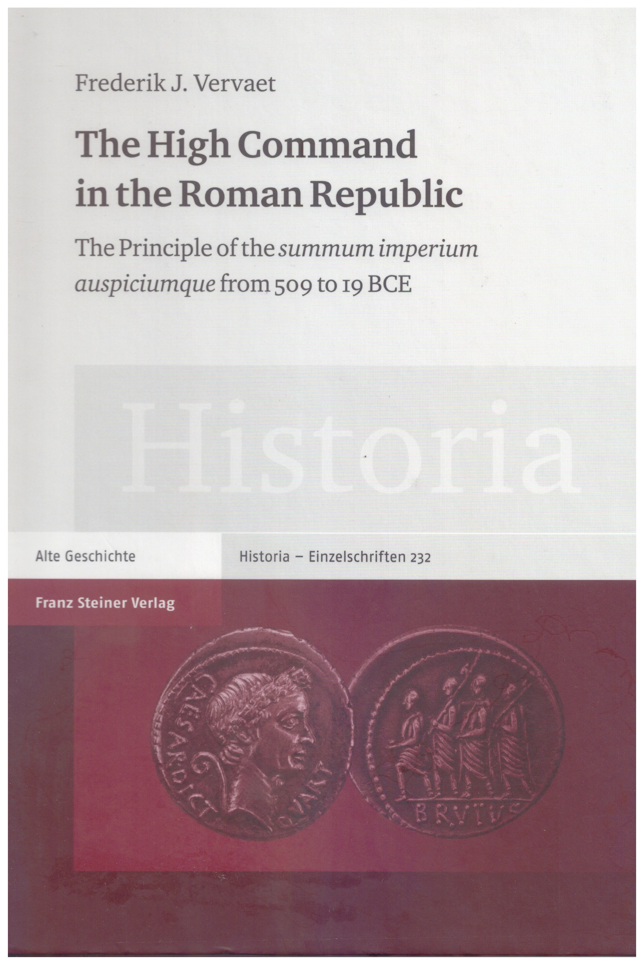

Slide 27
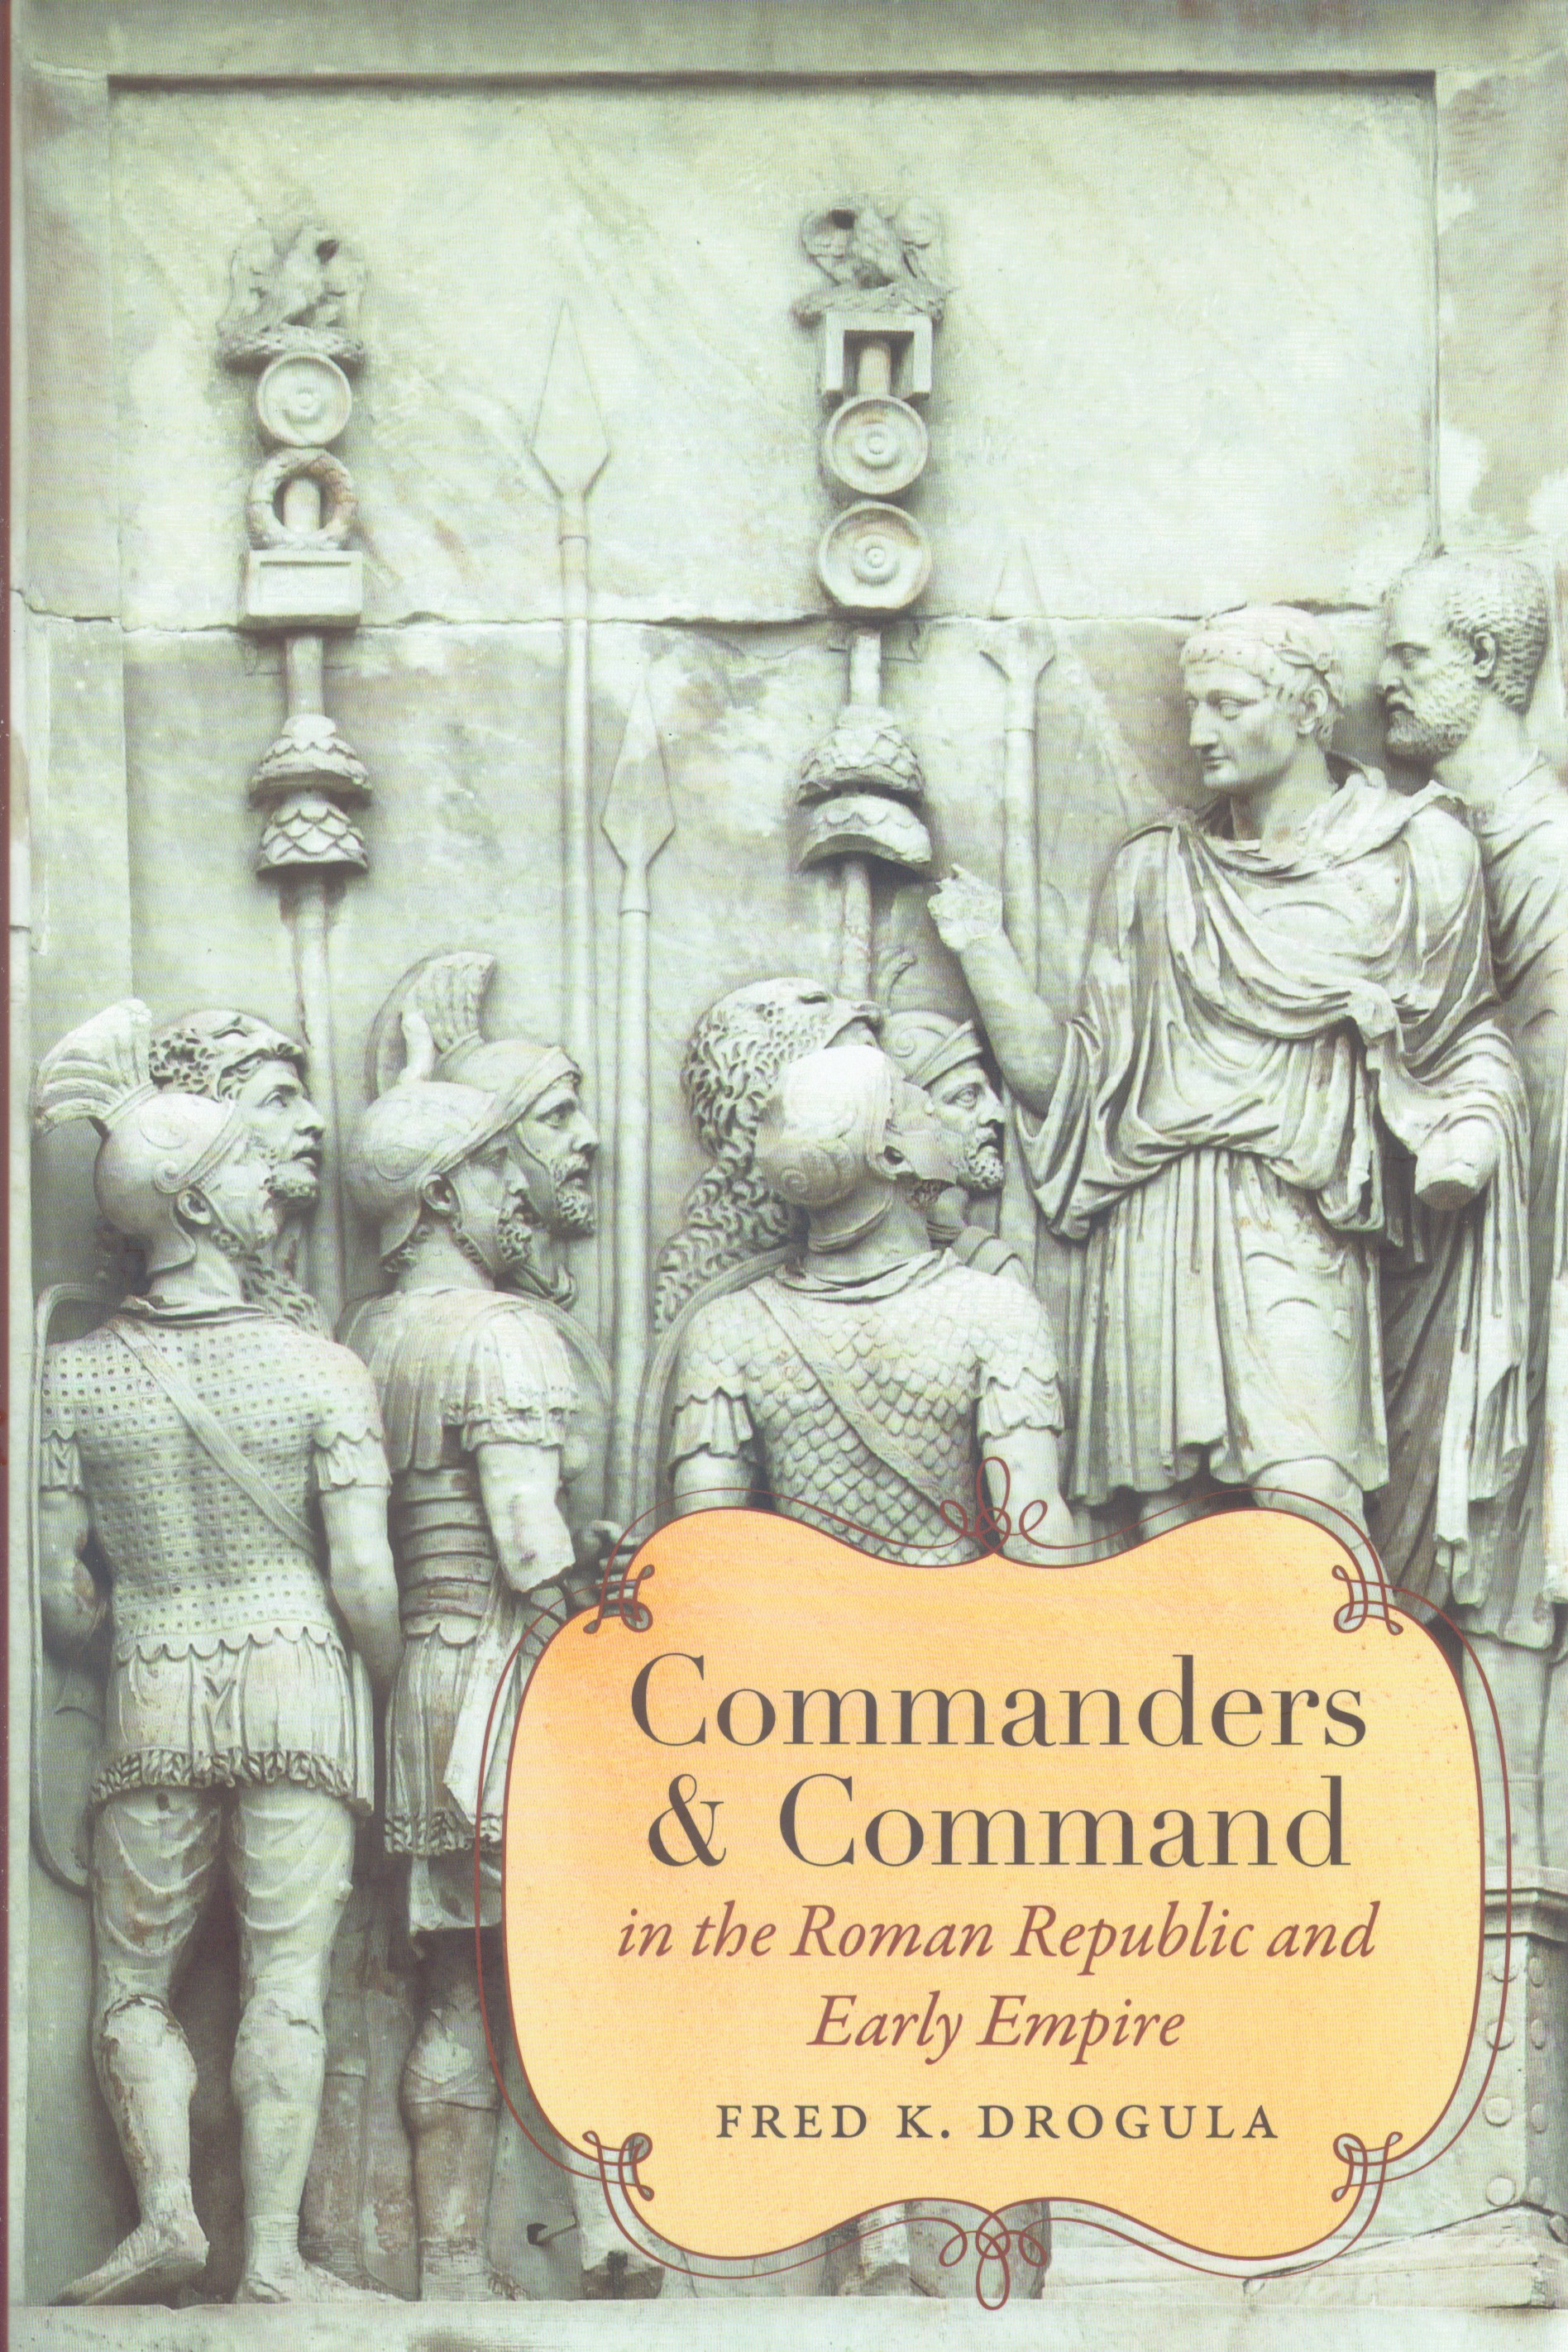

Slide 28


Slide 29


Slide 30


Slide 31
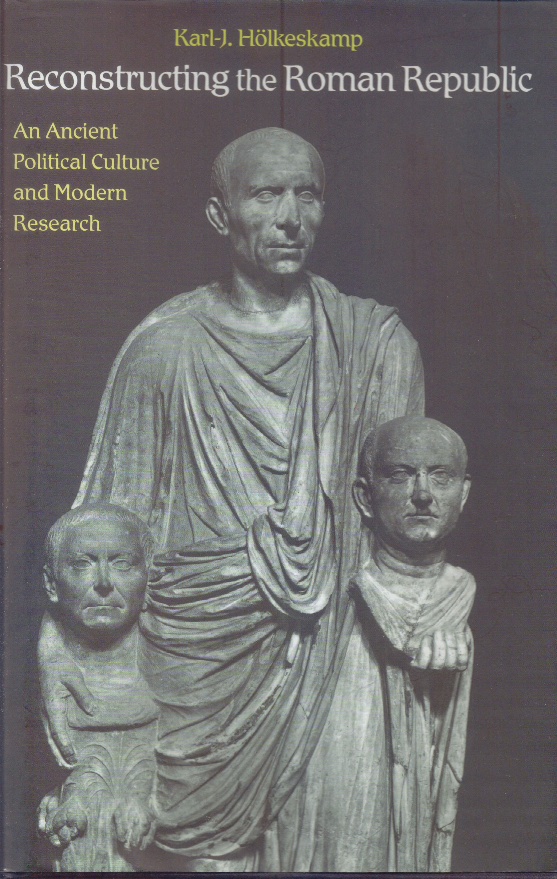

Slide 32


Slide 33


Slide 34
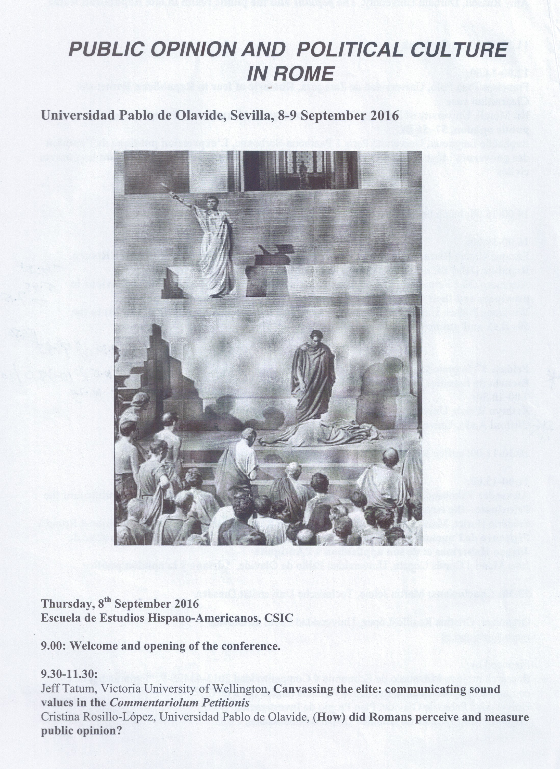

Slide 35
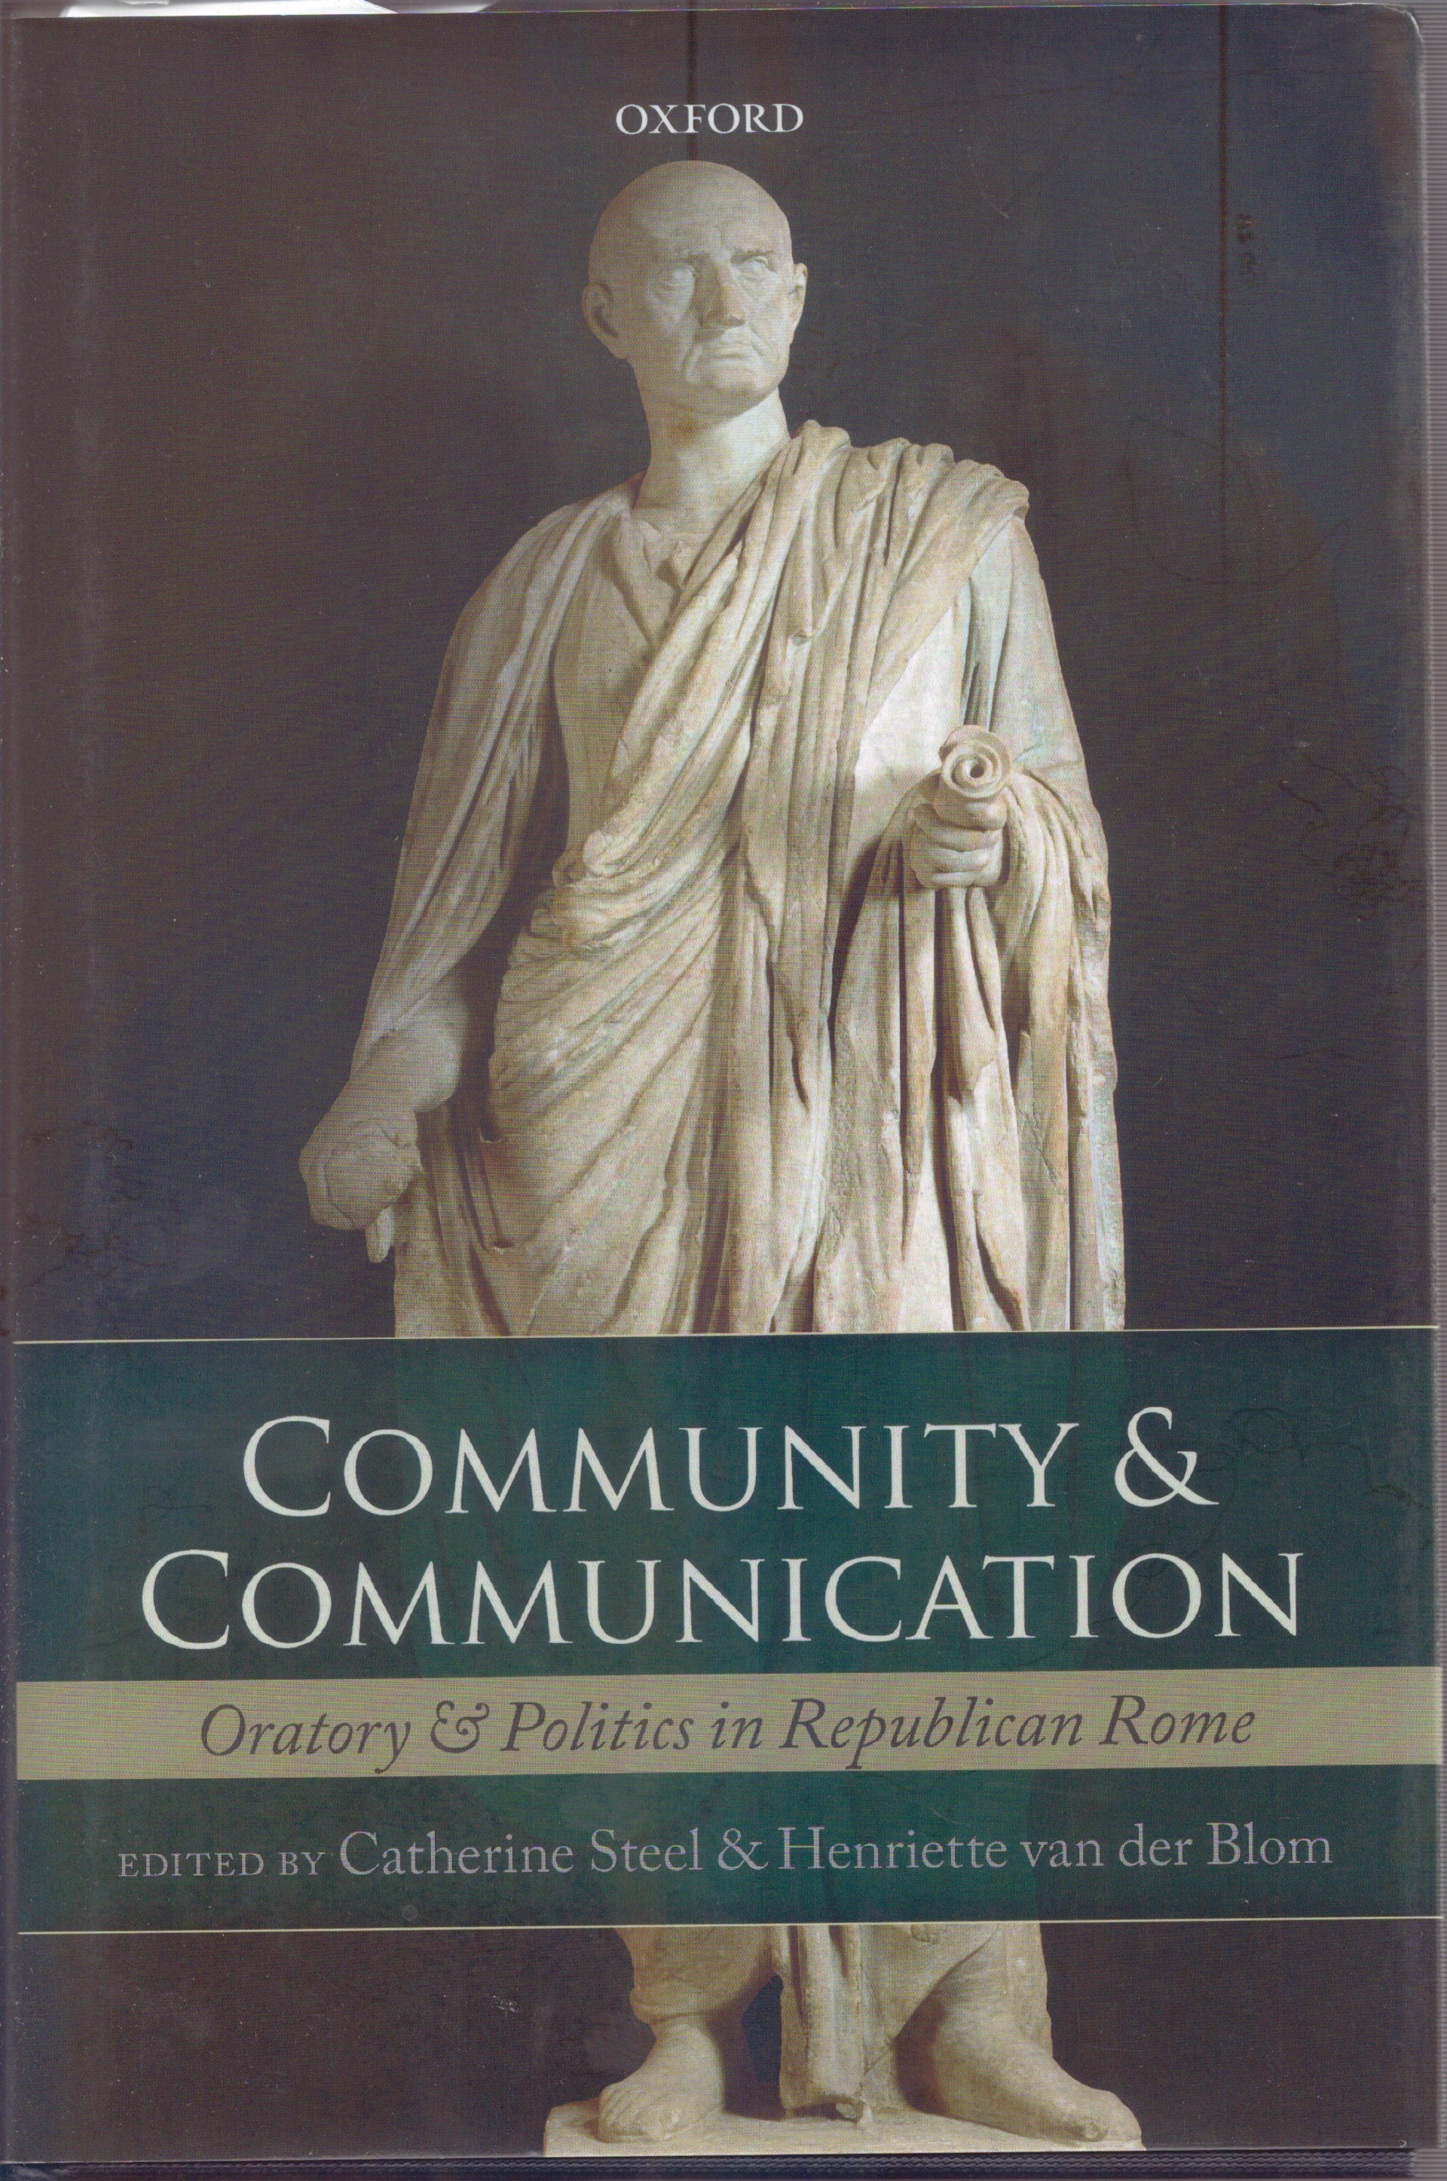

Slide 36



Slide 37


Slide 38


Slide 39


Slide 41
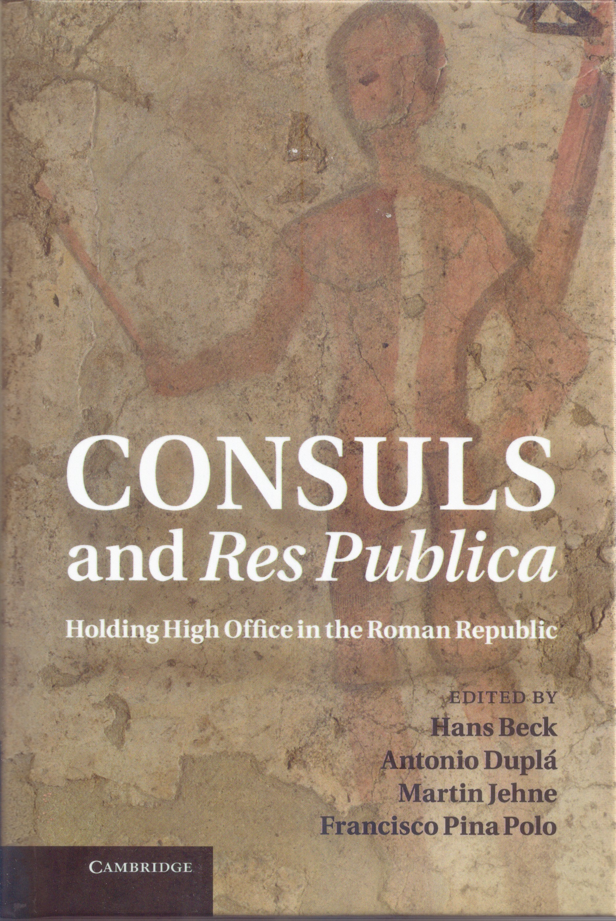

Slide 42


Slide 43


Slide 44
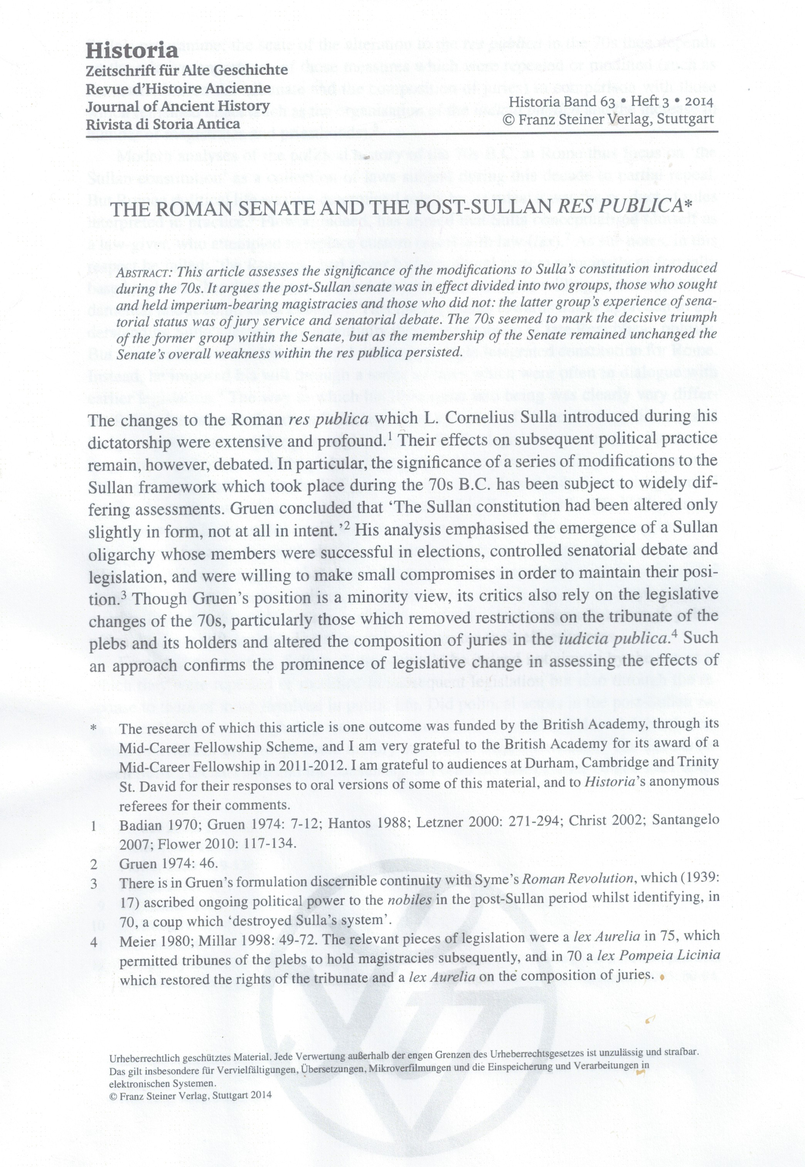
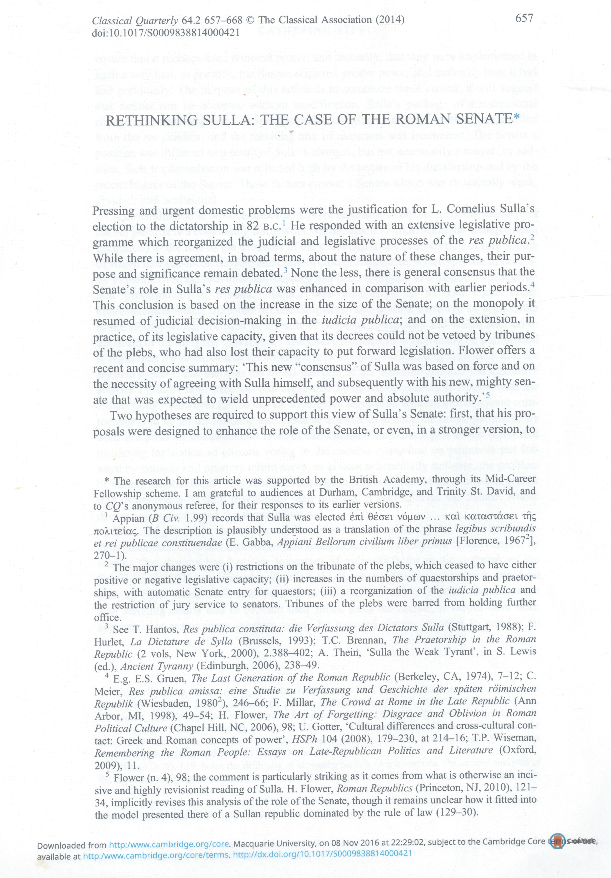

Slide 46


Slide 47
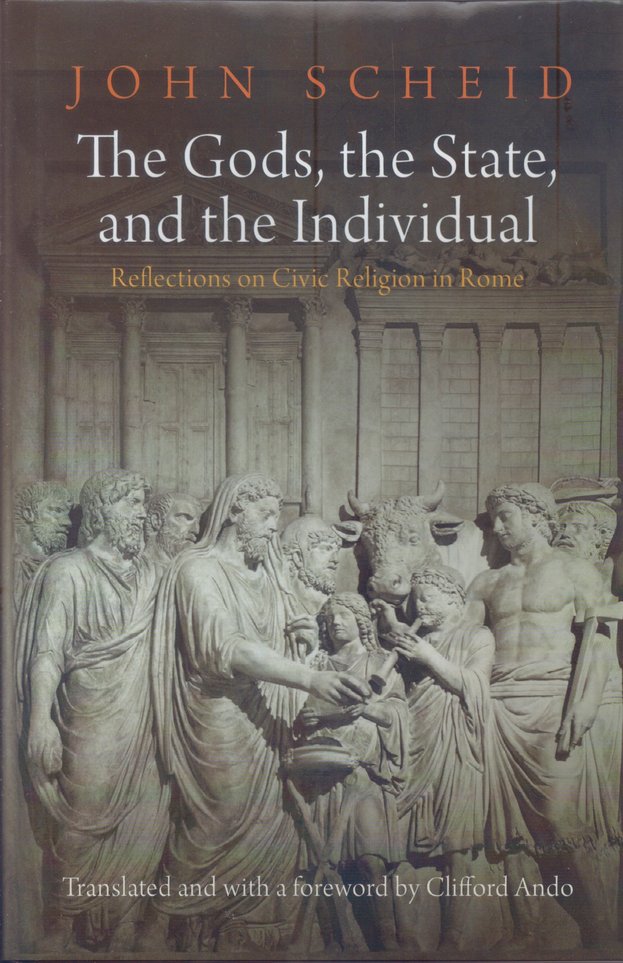

Slide 48
129 BC:
Livy, Periochae, 54
Obsequens 28a (2 snakes in Minerva’s temple) (= slaughter of citizens)
parhelia (two suns) (= great wars/deadly revolutions)
Notes:
48

Slide 49

129 BC:
Livy, Periochae, 54
Obsequens 28a (2 snakes in Minerva’s temple) (= slaughter of citizens)
parhelia (two suns) (= great wars/deadly revolutions)
Notes:
49

Slide 50

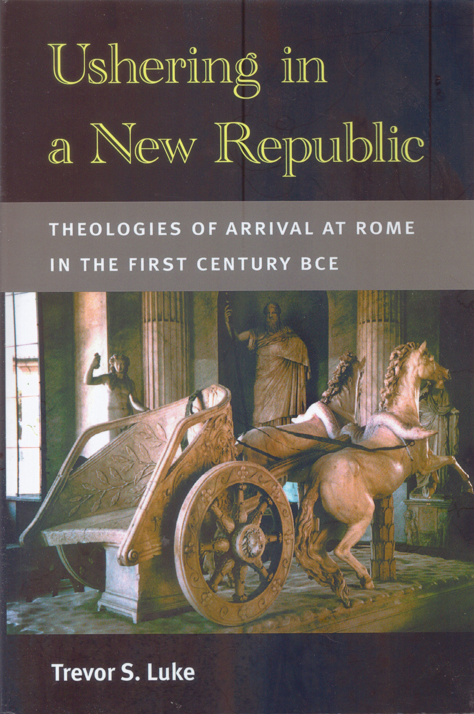

Slide 51


Slide 52



Slide 53


